Slide 1
The Boring Club Week 2

Slide 2
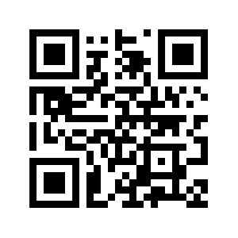
Discord
A place to interface with your team and see announcements
Bot will provide a introduction to the club and our resources
Please change your name in the channel to YOUR ACTUAL NAME
Notes:
Josh talk about Bot if finished?

Slide 3

Instagram
TBC related posts and stories
Meeting reminders
Other TBC events, (such as fundraisers)

Slide 4
Project Assignments

Slide 5
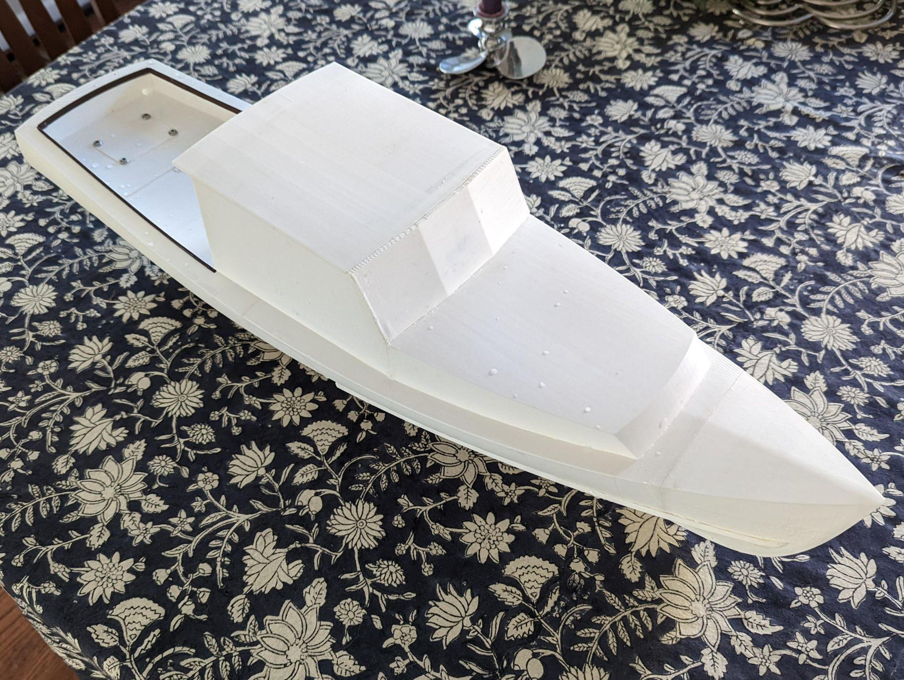
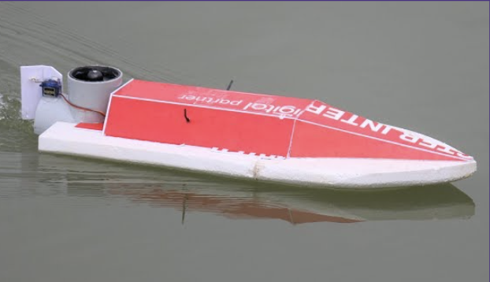
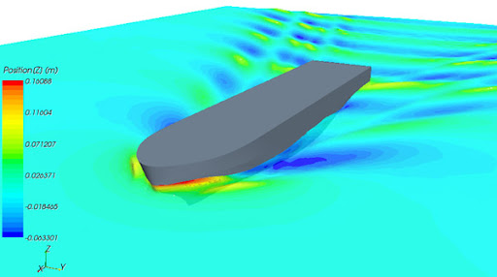
Mini Motorboat (Arjun)
Areas of focus : ECE, MechE, AeroE
Learn & develop skills: Arduino, 3D CAD, CFD modeling, C/C++, Circuit design
Later integrate alternate power sources

Slide 6
UW GPT (Arshan, this week Sam is covering)
UW version of Chat GPT which will essentially help answer all questions about UW
Helps develop software skills
Ties in with CS courses (CSE 12X, CSE 373)

Slide 7

Github/Git (Sean)
Platform for collaboration on coding and engineering projects
Version control and showcasing work
Build valuable skills you WILL use in the future
Only need 2-3 members for this project

Slide 8
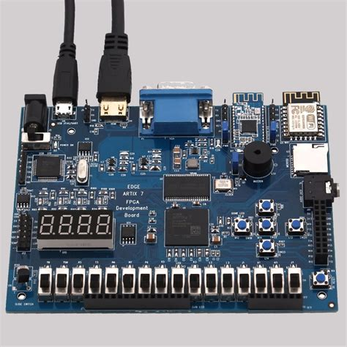
FPGA Digital System Sim (Sam)
Learn how to use digital logic (binary) to control a system
Program and simulate an FPGA chip
Create a system of your choice
E.g. traffic light, telephone operator, video game
Ties in with E E 271

Slide 9
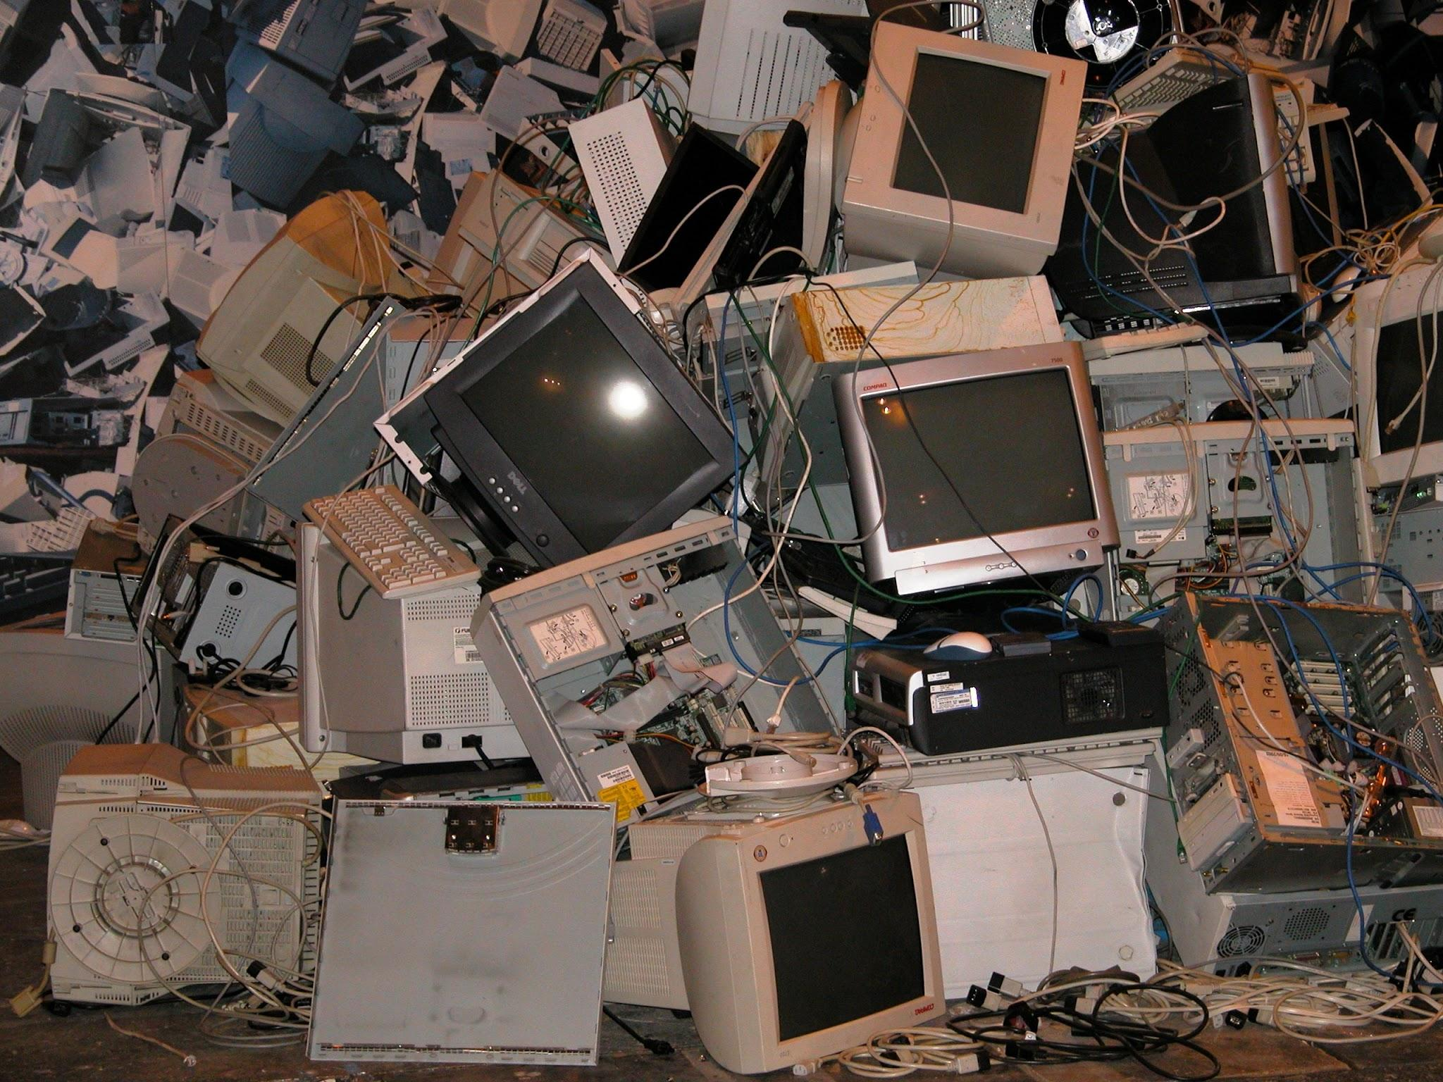
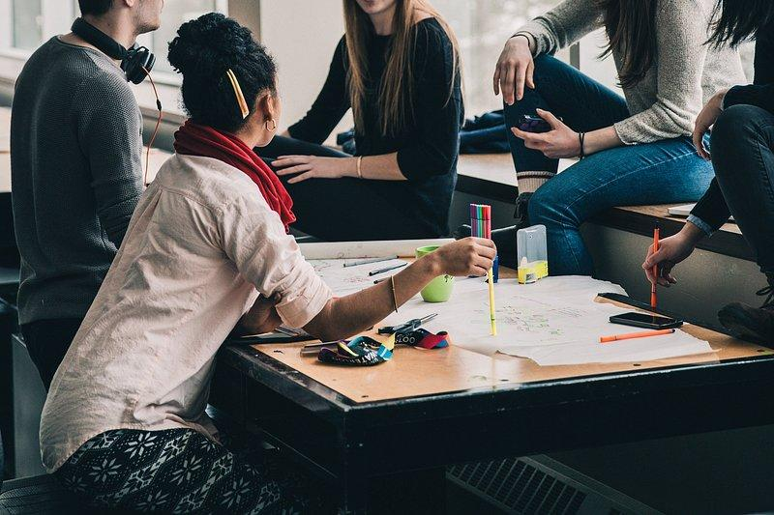
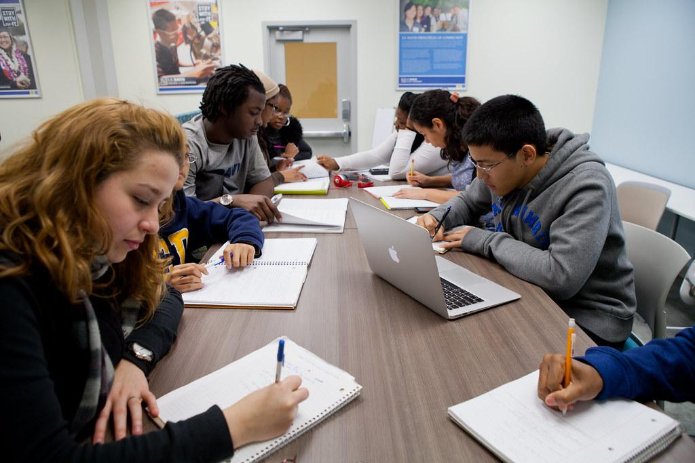
Projects
Let’s get to work!
Notes:
Josh talk about Bot if finished?

Slide 10
Closing Remarks
Meetings are weekly on Wednesday, here in SAV 169, 7-8 pm, (though we have the room until 9)
Please fill out your row in the spreadsheet
Questions? Thanks for coming!

